Slide 1
FHIR TSC update
Sept 19, 2016

Slide 2
Ballot Report
Ballot results
FHIR Core – 737
C-CDA on FHIR – 108
CQF - 220
DAF – 120
DAF Research – 75
SDC – 71
FluentPath – 34
Total 1365

Slide 3
Triage
Continue using gForge
Webinar emailed to co-chairs and FHIR lists
Detailed instructions on wiki
Link at the top of the tracker page
If you have issues/questions, contact me

Slide 4
Reconciliation Timelines
Proposed timeline to publish by year-end
Final content deadline: Dec. 4
FHIR Core Substantive change deadline: Nov. 11
Change proposal cut-off: Oct 9
Preliminary triage complete: Oct. 1
Are you ok with this timeline? Thur Q3

Slide 5
Resolution considerations
Priorities:
Must reconcile all ballot items
Can choose to defer non-urgent items (preferably with agreement of balloter)
Prioritize non-ballot items that may produce “substantive” change
Prioritize resources that are candidates for normative next round
Primarily infrastructure, administration and 1-2 domain resources (e.g. Observation)

Slide 6
Reconciliation Reminders
FHIR does not enforce best practices
Those are handled via profiles
FHIR is international in scope
Realm-specific concerns/guidance generally lives in profiles/extensions
STU 3 takes precedence over “Release 4”

Slide 7
What’s next?
FHIR “Release 4”
Ballot either Sept 2017 or Jan 2018 cycle
First release w/ Normative content
Working through process for combining STU and normative ballot process w/ TSC
Aim to publish by mid 2018

Slide 8
Resource maturity
Each resource has a maturity scale (0-5)
Try to get resources that are a candidate for normative to at least level 4
Let FMG know if you think your resource should be a candidate for normative next round
FMG may let you know that we’d like your resource to be a candidate for next round ☺

Slide 9
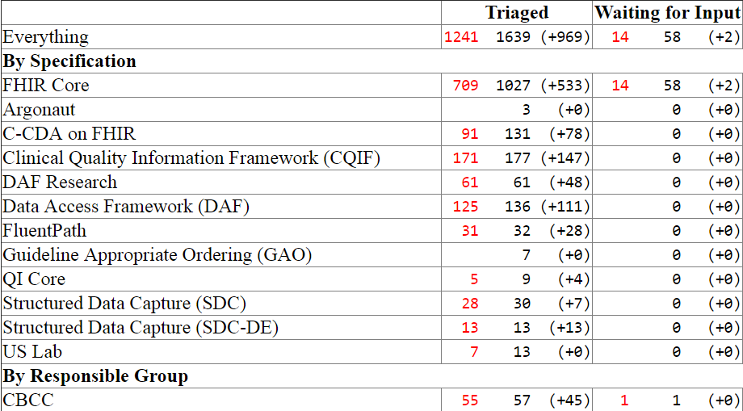
Tracker item management

Slide 10
Tracker item management
Triaged: ready to work on
Waiting for Input
Resolved-Unapplied
Closed
Updated
Stale (>90 days)

Slide 11
Maturity Model
FMG is putting together a maturity model for resources & profiles
Draft is here: http://wiki.hl7.org/index.php?title=FHIR_Maturity_Model
On publication, every resource and profile will have a maturity level assigned
Guidance for implementers on anticipated stability

Slide 12
Questions?
Your FMG Liaison
lmckenzie@gevityinc.com
david.hay25@gmail.com
(I’ll email this to co-chairs list within next hour)

